Slide 1
Accounting the data warehouse toolkit
Muhammad hamad

Slide 2
Introduction
Financial analysts are some of the most data-literate and spreadsheet-savvy individuals.
The DW system can provide a single source of usable, understandable financial information, ensuring everyone is working oﬀ the same data with common definitions and common tools.
Improved access to accounting data allows you to focus on opportunities to better manage risk, streamline operations, and identify potential cost savings.

Slide 3
General Ledger Data
The general ledger (G/L) is a core foundation financial system that ties together the detailed information collected by sub ledgers or separate systems for purchasing, payables (what you owe to others), and receivables (what others owe you).
The chart of accounts is a listing of all accounts used in the general ledger of an organization. The chart is used by the accounting software to aggregate information into an entity's financial statements.
The Period Close means that at the end of each accounting period, the finance organization is responsible for finalizing the financial results so that they can be officially reported internally and externally.

Slide 4
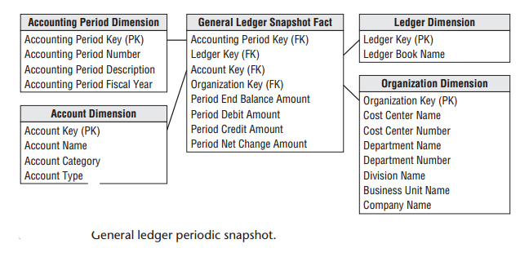

Slide 5
General Ledger Data
Year-to-Date Facts should be left out of the relational schema design and calculated in the BI reporting application instead.
Multiple Currencies Revisited If we have to deal with multiple currencies then in this case, each fact table row would represent one set of fact amounts expressed in local currency and a separate set of fact amounts on the same row expressed in the equivalent corporate currency.
If an anomaly is identified at the summary level, analysts want to look at the detailed transactions. The grain of the fact table is now one row for every general ledger journal entry transaction. The journal entry transaction identifies the G/L account and the applicable debit or credit amount.

Slide 6
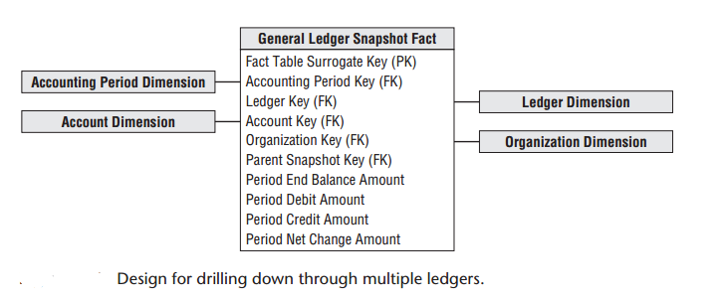
Drilling Down Through a Multilevel Hierarchy
Large enterprises may have multiple ledgers arranged in an ascending hierarchy, perhaps by enterprise, division, and department.
The division ledger entries may be consolidated to the enterprise level. One way to model this hierarchy is by introducing the parent snapshot’s fact table surrogate key in the fact table

Slide 7
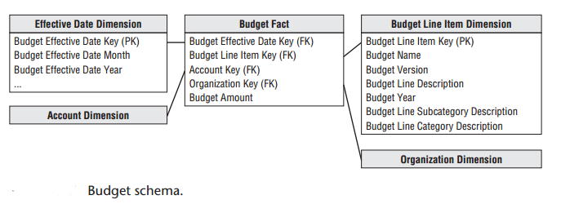
Budgeting Process
The budgeting process can be viewed as a series of events. Prior to the start of a fiscal year, each cost center manager typically creates a budget, broken down by budget line items.
Managers want to see the current budget’s status, as well as how the budget has been altered since the first approved version.
As a dimensional modeler, you can view the budgeting chain as a series of fact tables.

Slide 8
Dimension Attribute Hierarchies
Fixed Depth Positional Hierarchies
Slightly Ragged Variable Depth Hierarchies
Ragged Variable Depth Hierarchies
Time Varying Ragged Hierarchies

Slide 9
Consolidated Fact Tables
Fact tables that combine metrics from multiple business processes at a common granularity are referred to as consolidated fact tables.
Although consolidated fact tables can be useful, both in terms of performance and usability, they often represent a dimensionality compromise as they consolidate facts at the “least common denominator” of dimensionality.

Slide 10
Role of OLAP
OLAP products have been used extensively for financial reporting, budgeting, and consolidation applications.
Relational dimensional models often feed financial OLAP cubes. OLAP cubes can deliver fast query performance that is critical for executive usage.
OLAP is well suited to handle complicated organizational rollups, as well as complex calculations.

